Slide 1
UNIT IV – INTERNETWORKING
COMPUTER NETWORKING
CODE: IT 8137
FACILITATOR: FRANK
EMAIL: frankibrahim25@gmail.com

Slide 2
Internetworking Models
When networks first came into being, computers could typically communicate only with computers from the same manufacturer.
In the late 1970s, the Open Systems Interconnection (OSI) reference model was created by the International Organization for Standardization (ISO) to break this barrier.
The OSI model was meant to help vendors create interoperable network devices and software in the form of protocols so that different vendor networks could work with each other.

Slide 3
The OSI model is the primary architectural model for networks that describes how data and network information are communicated from an application on one computer, through the network media, to an application on another computer.
The Layered Approach
A reference model is a conceptual blueprint of how communications should take place.
It addresses all the processes required for effective communication and divides these processes into logical groupings called layers
When a communication system is designed in this manner, it’s known as layered architecture.

Slide 4
Advantages of Reference Models
It divides the network communication process into smaller and simpler components, thus aiding component development, design, and troubleshooting.
It allows multiple-vendor development through standardization of network components.
It encourages industry standardization by defining what functions occur at each layer of the model.
It allows various types of network hardware and software to communicate.
It prevents changes in one layer from affecting other layers, so it does not hamper development.

Slide 5
The OSI Reference Model
The OSI isn’t a physical model, it’s a set of guidelines that application developers can use to create and implement applications that run on a network.
It also provides a framework for creating and implementing networking standards, devices, and internetworking schemes.
The OSI has seven different layers, divided into two groups.
The top three layers define how the applications within the end stations will communicate with each other and with users.
The bottom four layers define how data is transmitted end-to-end.

Slide 6
The OSI reference model has seven layers:
Application layer (layer 7)
Presentation layer (layer 6)
Session layer (layer 5)
Transport layer (layer 4)
Network layer (layer 3)
Data Link layer (layer 2)
Physical layer (layer 1)
The Application Layer
The Application layer of the OSI model marks the spot where users actually communicate to the
computer.

Slide 7
This layer only comes into play when it’s apparent that access to the network is going to be needed soon.
The Application layer is also responsible for identifying and establishing the availability of the intended communication partner, and determining whether sufficient resources for the intended communication exist.
The Presentation Layer
It presents data to the Application layer and is responsible for data translation and code formatting.
This layer is essentially a translator and provides coding and conversion functions.

Slide 8
The OSI has protocol standards that define how standard data should be formatted. Tasks like data compression, decompression, encryption, and decryption are associated with this layer.
The Session Layer
The Session layer is responsible for setting up, managing, and then tearing down sessions between Presentation layer entities.
This layer also provides dialogue control between devices, or nodes.
It coordinates communication between systems, and serves to organize their communication by offering three different modes: simplex, half duplex, and full duplex.

Slide 9
The Transport Layer
The Transport layer segments and reassembles data into a data stream.
They provide end-to-end data transport services and can establish a logical connection between the sending host and destination host on an internetwork.
The Transport layer is responsible for providing mechanisms for multiplexing upper-layer applications, establishing sessions, and tearing down virtual circuits.
The Transport layer can be connectionless or connection-oriented.

Slide 10
The Network Layer
The Network layer (also called layer 3) manages device addressing, tracks the location of devices on the network, and determines the best way to move data, which means that the Network layer must transport traffic between devices that aren’t locally attached.
Routers (layer 3 devices) are specified at the Network layer and provide the routing services within an internetwork.
The Data Link Layer
The Data Link layer provides the physical transmission of the data and handles error notification, network topology, and flow control.

Slide 11
This means that the Data Link layer will ensure that messages are delivered to the proper device on a LAN using hardware addresses, and translates messages from the Network layer into bits for the Physical layer to transmit.
The Data Link layer formats the message into pieces, each called a data frame, and adds a customized header containing the hardware destination and source address.
The Physical Layer
The Physical layer does two things: It sends bits and receives bits. Bits come only in values of 1 or 0.
The Physical layer communicates directly with the various types of actual communication media.

Slide 12
The Physical layer specifies the electrical, mechanical, procedural, and functional requirements for activating, maintaining, and deactivating a physical link between end systems.
This layer is also where you identify the interface between the data terminal equipment (DTE) and the data communication equipment (DCE).

Slide 13
Ethernet Networking
Ethernet is a contention-based media access method that allows all hosts on a network to share the same link’s bandwidth.
Ethernet is popular because it’s readily scalable, meaning that it’s comparatively easy to integrate new technologies, such as Fast Ethernet and Gigabit Ethernet, into an existing network infrastructure.
It really pretty simple to implement and it makes troubleshooting fairly straightforward as well.
Ethernet uses both Data Link and Physical layer specifications.

Slide 14
Collision Domain
Collision domain refers to a network scenario wherein one device sends a frame out on a physical network segment forcing every other device on the same segment to pay attention to it.
This is bad because if two devices on a single physical segment just happen to transmit simultaneously, it will cause a collision and require these devices to retransmit.
Think of a collision event as a situation where each device’s digital signals totally interfere with one another on the wire.
Broadcast Domain: refers to a group of devices on a specific network segment that hear all the broadcasts sent out on that specific network segment.

Slide 15
CSMA/CD
Ethernet networking uses a protocol called Carrier Sense Multiple Access with Collision Detection (CSMA/CD), which helps devices share the bandwidth evenly while preventing two devices from transmitting simultaneously on the same network medium.
CSMA/CD was actually created to overcome the problem of the collisions that occur when packets are transmitted from different nodes at the same time.
How does the CSMA/CD protocol work?
When a host wants to transmit over the network, it first checks for the presence of a digital signal on the wire. If all is clear and no other host is transmitting, the host will then proceed with its transmission.

Slide 16
The transmitting host constantly monitors the wire to make sure no other hosts begin transmitting. If the host detects another signal on the wire, it sends out an extended jam signal that causes all nodes on the segment to stop sending Data think busy signal.
The nodes respond to that jam signal by waiting a bit before attempting to transmit again.
Ethernet at the Data Link Layer
Ethernet at the Data Link layer is responsible for Ethernet addressing, commonly referred to as MAC or hardware addressing.
Ethernet is also responsible for framing packets received from the Network layer and preparing them for transmission on the local network through the Ethernet contention-based media access method.

Slide 17
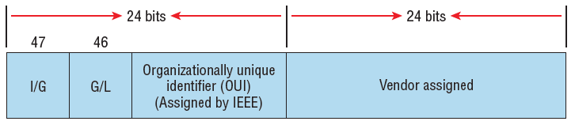
Ethernet Addressing
It uses the Media Access Control (MAC) address burned into each and every Ethernet network interface card (NIC).
The MAC, or hardware, address is a 48-bit (6-byte) address written in a hexadecimal format.
Ethernet addressing using MAC addresses

Slide 18
The organizationally unique identifier (OUI) is assigned by the IEEE to an organization.
It’s composed of 24 bits, or 3 bytes, and it in turn assigns a globally administered address also made up of 24 bits, or 3 bytes, that’s supposedly unique to each and every adapter an organization manufactures.
The high-order bit is the Individual/Group (I/G) bit.
When it has a value of 0, we can assume that the address is the MAC address of a device and that it may well appear in the source portion of the MAC header.
When it’s a 1, we can assume that the address represents either a broadcast or multicast address in Ethernet.

Slide 19
The next bit is the Global/Local bit(G/L), or U/L bit, where U means universal.
When set to 0, this bit represents a globally administered address, as assigned by the IEEE, but when it’s a 1, it represents a locally governed and administered address.
The low-order 24 bits of an Ethernet address represent a locally administered or manufacturer-assigned code. This portion commonly starts with 24 0s for the first card made and continues in order until there are 24 1s for the last card made.

Slide 20
Ethernet at the Physical Layer
Ethernet was first implemented by a group called DIX, which stands for Digital, Intel, and Xerox.
They created and implemented the first Ethernet LAN specification, which the IEEE used to create the IEEE 802.3 committee.
This was a 10 Mbps network that ran on coax and then eventually twisted-pair and fiber physical media.
Some of the most common IEEE Ethernet standards
10Base-T (IEEE 802.3) 10 Mbps using category 3 unshielded twisted pair (UTP) wiring for runs up to 100 meters.
Each device must connect into a hub or switch, and you can have only one host per segment or wire. It uses a physical star topology and a logical bus.

Slide 21
100Base-TX (IEEE 802.3u) 100Base-TX, most commonly known as Fast Ethernet. Uses EIA/TIA category 5, 5E, or 6 UTP two-pair wiring. One user per segment; up to 100 meters long.
It uses an RJ45 connector with a physical star topology and a logical bus.
100Base-FX (IEEE 802.3u) Uses fiber cabling 62.5/125-micron multimode fiber. Point-to-point topology; up to 412 meters long. It uses ST and SC connectors, which are media-interface connectors.
1000Base-T (IEEE 802.3ab) Category 5, four-pair UTP wiring up to 100 meters long and up to 1 Gbps.

Slide 22
Lab works
Ethernet Cabling
Media Connectors
A variety of connectors are used with the associated network media.
Media connectors attach to the transmission media and allow the physical connection into the computing device.
RJ-11 Connectors
RJ- (registered jack) 11 connectors are small plastic connectors used on telephone cables. They have capacity for six small pins.

Slide 23
RJ-45 Connectors
RJ-45 connectors are used with twisted-pair cabling, the most prevalent network cable in use today.
RJ-45 connectors resemble the aforementioned RJ-11 phone jacks, but they support up to eight wires instead of the six supported by RJ-11 connectors.
568A and 568B Wiring Standards
568A and 568B are telecommunications standards from TIA and EIA.
These 568 standards specify the pin arrangements for the RJ-45 connectors on UTP or STP cables.

Slide 24
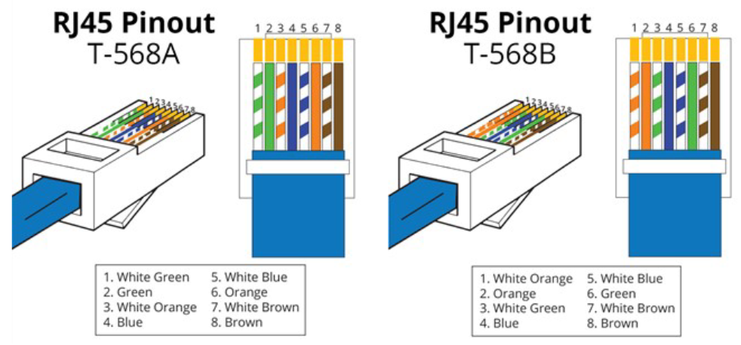
The number 568 refers to the order in which the wires within the Category 5 cable are terminated and attached to the connector.
The 568A and 568B standards are quite similar; the difference is the order in which the pins are terminated.

Slide 25
The types of Ethernet cables available are:
Straight-through cable
Crossover cable
Rolled cable
Straight Through Cable
A straight through cable is a type of twisted pair cable that is used in local area networks to connect a computer to a network hub such as a router or Router to switch or hub.
On a straight through cable, the wired pins match.

Slide 26
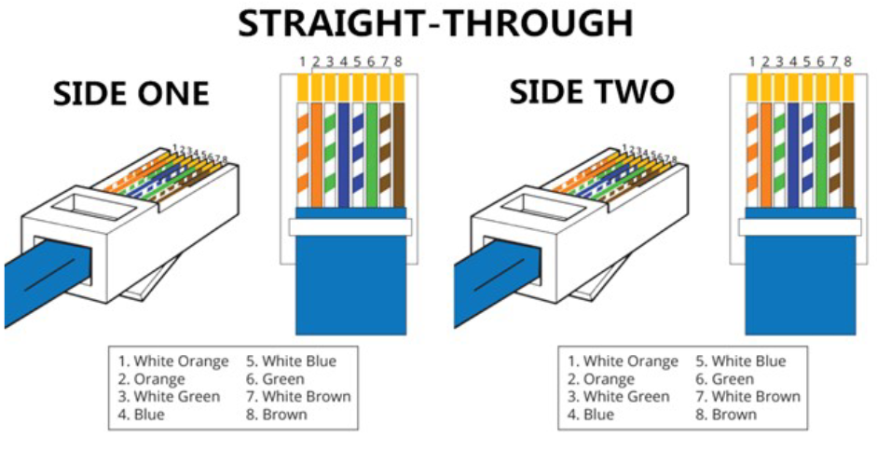
Straight through cable use one wiring standard: both ends use T568A wiring standard or both ends use T568B wiring standard.
The following figure shows a straight through cable of which both ends are wired as the T568B standard.

Slide 27
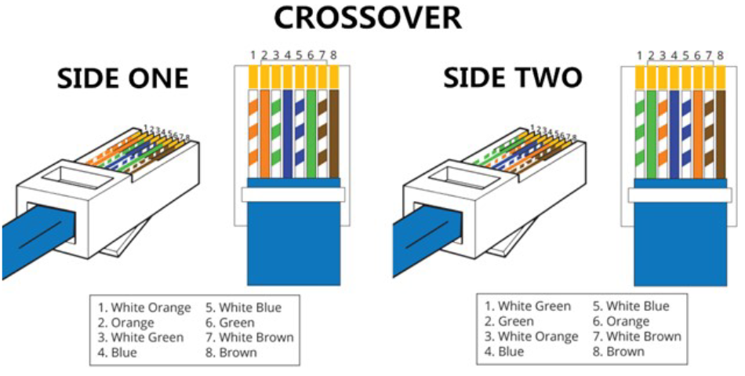
Crossover Cable
A crossover Ethernet cable is a type of Ethernet cable used to connect computing devices together directly.
The RJ45 crossover cable uses two different wiring standards: one end uses the T568A wiring standard and the other end uses the T568B wiring standard.
It is most often used to connect two devices of the same type: e.g. two computers (via network interface controller) or two switches to each other.

Slide 28
Straight through vs Crossover Cable
Usually, straight through cables are primarily used for connecting unlike devices. And crossover cables are use for connecting alike devices.
Use straight through Ethernet cable for the following cabling:
Switch to router
Switch to PC or server
Hub to PC or server
Use crossover cables for the following cabling:
Switch to switch
Hub to hub
Router to router
PC to PC

Slide 29
Rollover
The rollover cable is a Cisco Systems proprietary cable used to connect a computer system to a router or switch console port.
The rollover cable resembles an Ethernet UTP cable; however, it is not possible to use it on anything but Cisco equipment.
Like UTP cable, the rollover cable has eight wires inside and an RJ-45 connector on each end that connect to the router and the computer port.

